Slide 1
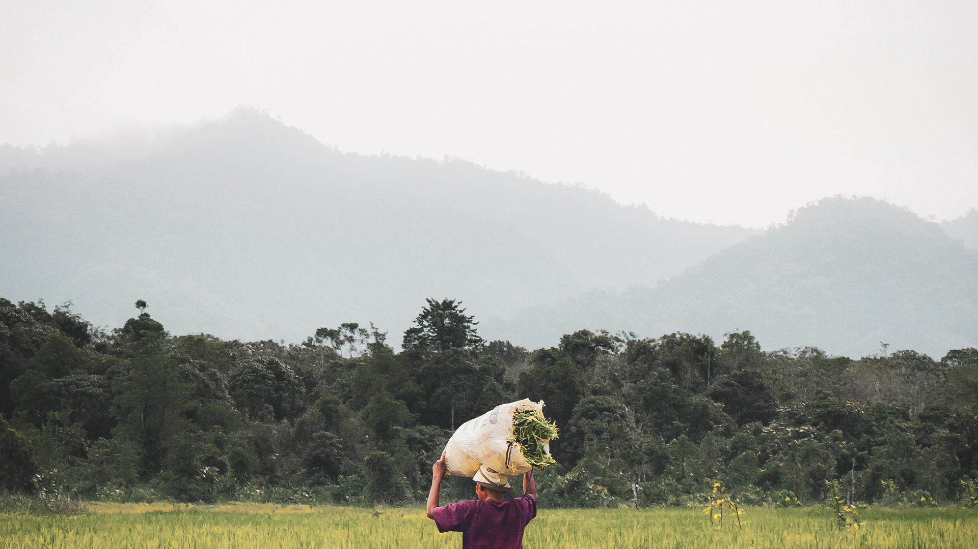
Notes:
**If you have any questions about this PowerPoint, please contact your Bread for the World organizer: https://www.bread.org/offering-letters/#regional-organizers. Visit www.bread.org/OL for more info.**
Use and adapt some or all of these slides in a way that works for your context. Each slide includes a script in the notes section, which can help guide your presentation. Feel free to use your own words!
Slide 1: “Welcome to this presentation of Bread for the World, the farm bill, and the Offering of Letters.”

Slide 2
AGENDA
Opening prayer
What is Bread for the World?
Celebration of 2022 Victories
Food Insecurity in the U.S.
Global Hunger
Why Does Bread Advocate on the Farm Bill?
2023 Farm Bill Campaign
Offering of Letters
Closing Prayer & Adjourn
Notes:
Slide 2: “We will start with an opening prayer, followed by a brief description of Bread for the World, and then a review and celebration of our most significant victories last year. Then, we will share some information on hunger and food insecurity, first in the U.S., and then globally. After that, we will turn our attention to the farm bill—why does Bread advocate on the farm bill, what’s in it, what are Bread’s priorities for the next farm bill, and where are we at in Bread’s farm bill campaign. Finally, we’ll turn our attention to the Offering of Letters, providing a quick glance at the website and showing you where to find the resources you’ll need.”

Slide 3
“For I know the plans I have for you,” declares the LORD, “plans to prosper you and not to harm you, plans to give you hope and a future.”
Jeremiah 29:11
Notes:
Slide 3: “We’re going to start by centering ourselves with this well-known Bible passage, and I encourage you to make it a prayer, placing your trust in God. [pause] For I know the plans I have for you, declares the Lord, plans to prosper you and not to harm you, plans to give you hope and a future. [pause] Amen.”

Slide 4
Bread for the World
Bread for the World is a Christian advocacy organization urging U.S. decision makers to do all they can to pursue a world without hunger.
Our mission is to educate and equip people to advocate for policies and programs that can help end hunger in the U.S. and around the world.
Notes:
Slide 4: “Bread for the World is a Christian advocacy organization urging U.S. decision makers to do all they can to pursue a world without hunger. Our mission is to educate and equip people to advocate for policies and programs that can help end hunger in the U.S. and around the world.”

Slide 5
Celebration of 2022 victories – Giving hope and a future
Global Malnutrition Prevention and Treatment Act (GMPTA) (10-19-22): Bread Celebrates Passage of Bipartisan Global Malnutrition Bill
Global Food Security Act (GFSA) (12-15-22): Bread Celebrates Global Food Security Act Reauthorization
Expanded Summer Nutrition Programs (12-21-22): Bread Statement on the Summer Nutrition Agreement for Children
Notes:
Slide 5: “Last year, we advocated for legislation that will continue and accelerate progress in reducing hunger, both globally and here in the U.S. Here we have our three top legislative victories of 2022, which Bread for the World members, churches and campuses played a key role in helping to achieve: passing the Global Malnutrition Prevention and Treatment Act, reauthorizing the Global Food Security Act, and expanding and increasing access to summer meals for children in the U.S. You can see that we’ve included links to Bread’s press releases about these victories. And each of these victories has its own slide as well, slides 6 through 8, if you would like to learn more. In the interest of time, I’m going to move through these slides quickly and highlight some key points about the human impact.”

Slide 6
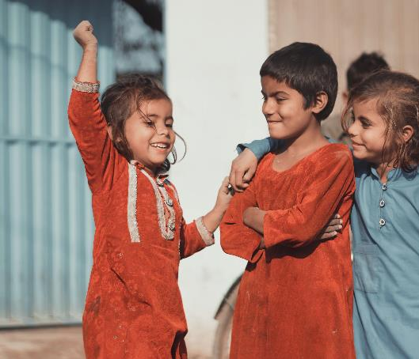
Bread 2022 Recent Victories
Global Malnutrition Prevention and Treatment Act (GMPTA)
The Global Malnutrition Prevention and Treatment Act will bring greater strategic vision, effectiveness, and accountability to the United States’ existing global nutrition efforts and will help mitigate and prevent future hunger and malnutrition crises. The legislation will also improve coordination within the U.S. government and with partner countries to ensure assistance gets to the children and families who need it most.
Notes:
Slide 6: “The Global Malnutrition Prevention and Treatment Act was passed last October, and it will help mitigate and prevent future hunger and malnutrition crises and ensure assistance gets to the children and families who need it most.”

Slide 7
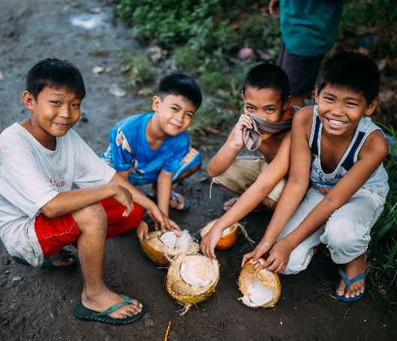
Bread 2022 Recent Victories
Global Food Security Act (GFSA)
Since enacted in 2016, the GFSA has played a crucial role in ensuring agricultural development in low-income countries through its Feed the Future initiative. These efforts have led to the success of nearly 23.4 million more people living above the poverty line and more than 1,000 agricultural innovations.
Notes:
Slide 7: “The Global Food Security Act was passed last December, and it reauthorizes legislation supporting agricultural development in low-income countries that has already help lift nearly 23.4 million people above the poverty line.”

Slide 8
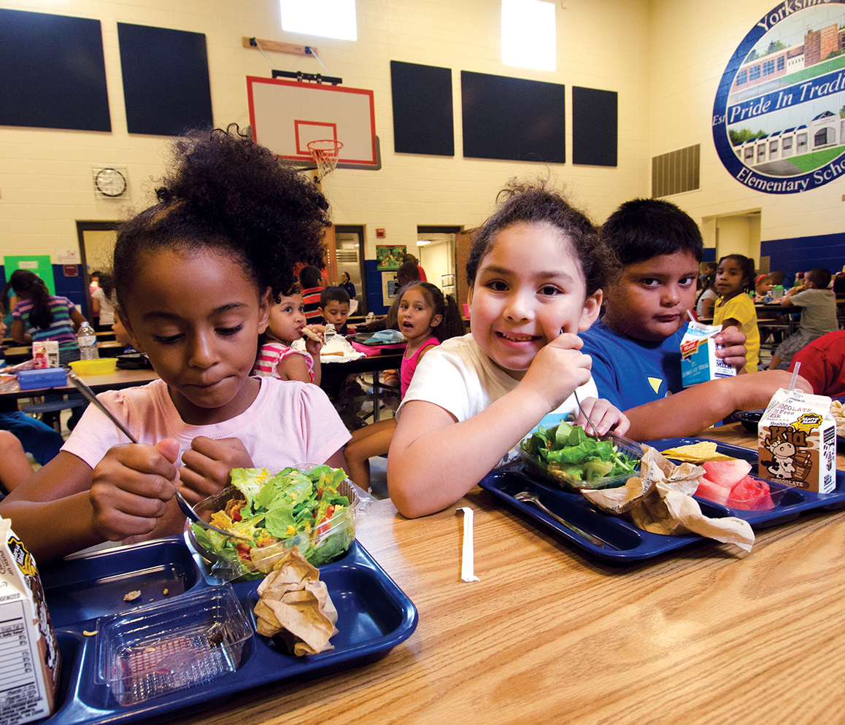
Bread 2022 Recent Victories
Expanded summer nutrition programs for children in the U.S.
In 2019, approximately 80% of children who were eligible for summer meals did not access them. The omnibus appropriations legislation passed in December 2022 will help change that by expanding the summer Electronic Benefits Transfer (EBT) program nationwide and enabling summer meal programs to be more flexible. This will significantly increase access to summer meals and help prevent child hunger, particularly in rural communities.
Notes:
Slide 8: “And at the end of last year, improvements were made to summer nutrition programs that will significantly increase access to summer meals and help prevent child hunger in the U.S.
“These victories truly are a cause for celebration because they will bring help and hope for a brighter future for children and families here in our country and around the world. And these victories inspire and encourage us to continue our work together, even as we face ongoing challenges domestically and internationally.”

Slide 9
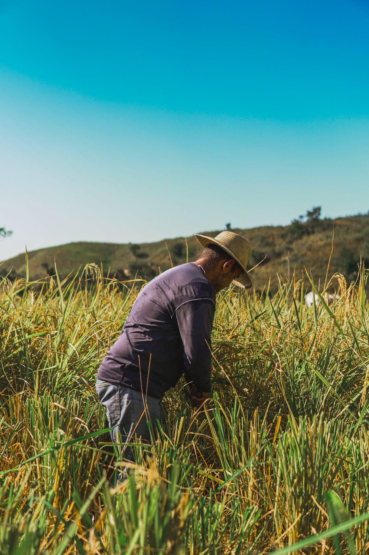
Hunger in the United States
Nearly 15 percent of U.S. households — more than 40 million Americans, including 12 million children — struggle to put food on the table.
Here the measure of hunger is “food insecurity” — an ongoing uncertainty of where the next meal will come from.
More than 1 in 5 U.S. children are at risk of hunger (1 in 3 among Black and Latino(a) children).
A majority of Americans (51.4 percent) will live in poverty at some point before age 65.
Notes:
Slide 9: “Let’s take a look at some of those challenges. Here in the United States, nearly 15 percent of households—more than 40 million Americans, 12 million of whom are children—struggle to put food on the table. “Food insecurity” is the term typically used to describe hunger in the U.S. It’s an ongoing uncertainty of where the next meal will come from. More than 1 in 5 children are at risk of hunger or food insecurity, 1 in 3 among Black and Latino children. And a majority of Americans will live in poverty at some point before age 65.”

Slide 10
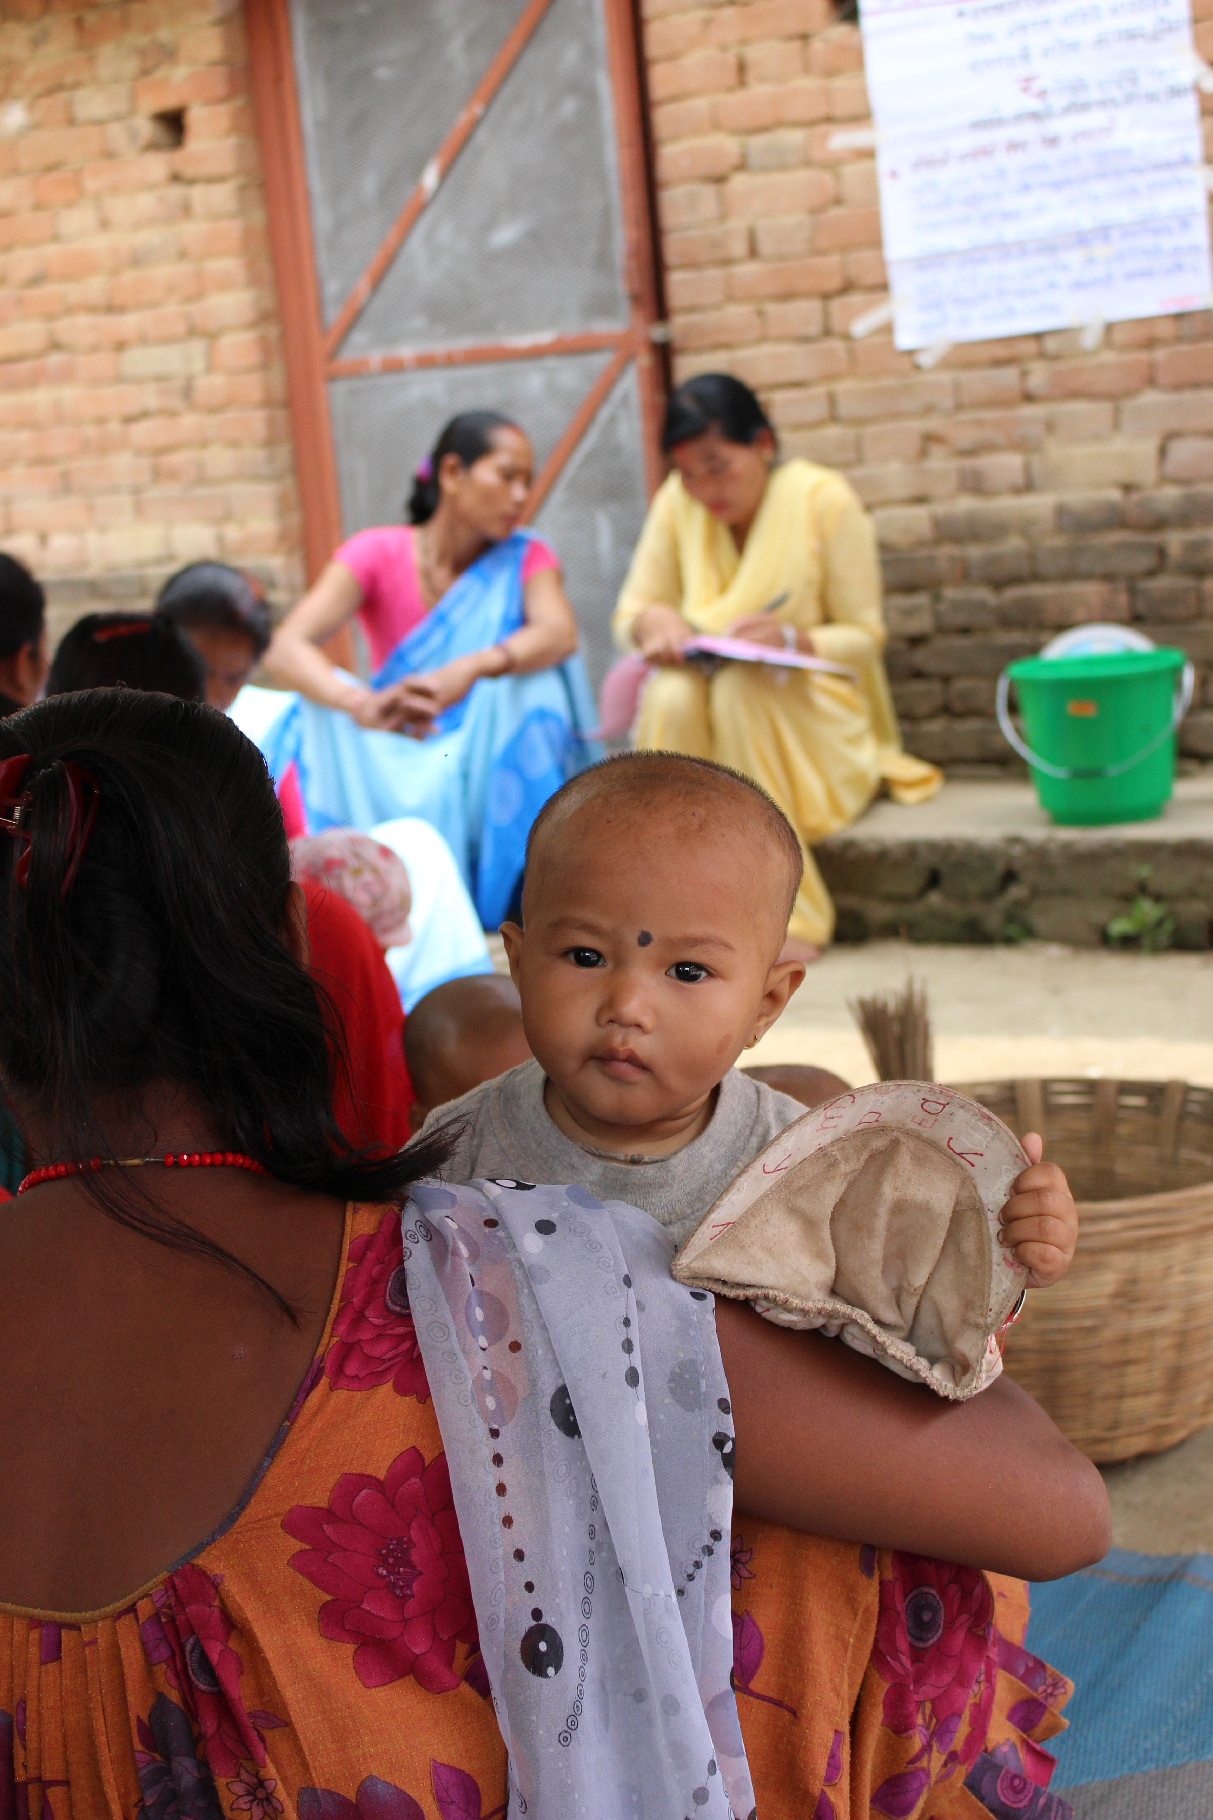
Global Hunger
More than enough food is produced in the world to feed everyone, but…
As many as 828 million people still go hungry, and…
After steadily declining for a decade, world hunger is on the rise, affecting nearly 10% of people globally.¹
The global crisis that steadily worsened during 2022 continues in 2023. In 2014, 81 million people needed lifesaving humanitarian assistance. In 2023, nearly 340 million people do.²
Notes:
Slide 10: “Although we’ve all heard that there is enough food to feed everyone globally, as many as 828 million people still go hungry. After steadily declining for a decade, world hunger is on the rise, affecting nearly 10% of people globally. And the hunger crisis that steadily worsened during 2022 continues this year. For perspective, in 2014, 81 million people needed lifesaving humanitarian assistance. In 2023, nearly 340 million people do.
“When we step back, we see that from when Bread for the World began in 1974 to today, we have made truly remarkable progress against hunger and poverty. When Bread began in 1974, 1 in 3 people were hungry. Today, it’s 1 in 10, all the more remarkable as the population has increased exponentially during that time. 1 in 10 is still too high, but it’s amazing to see such progress. However, in the past few years we’ve been moving in the wrong direction. The bottom line: there’s still work to be done.”

Slide 11
Why Does Bread Advocate on the Farm Bill?
U.S. policies and programs impact the lives and livelihood of people in the U.S. and in every corner of the world. This worldwide impact is especially true of large, multifaceted legislation like the U.S. farm bill. Every five years, Congress must reauthorize the farm bill, and every five years, Bread is at the table advocating for a bill that helps ensure all people, in every corner of the world, can survive and thrive. Our faith calls us to engage, and we know that if we do not speak up, other voices and interests will fill the silence.
The farm bill impacts all of us because it helps shape local, regional, national and global food systems (i.e., the path food travels from farm to fork). In 2023, Bread for the World is calling for a farm bill that builds healthy, equitable, and sustainable food systems, both domestically and internationally. We know that the whole human family is connected, and that local and global food systems overlap and intersect in various ways. As people called to love our neighbors as ourselves, we seek to influence this far-reaching legislation for the benefit of those most in need, both near and far, and for a stronger and brighter future for all.
Notes:
Slide 11: “Which brings us to the farm bill. In the next few slides, we will share a little more about what’s in the farm bill. But first we want to talk about why Bread for the World advocates on the farm bill. I’m going to read these two paragraphs out loud, and you’re welcome to follow along on the slide.
“U.S. policies and programs impact the lives and livelihood of people in the U.S. and in every corner of the world. This worldwide impact is especially true of large, multifaceted legislation like the U.S. farm bill. Every five years, Congress must reauthorize the farm bill, and every five years, Bread is at the table advocating for a bill that helps ensure all people, in every corner of the world, can survive and thrive. Our faith calls us to engage, and we know that if we do not speak up, other voices and interests will fill the silence.
“The farm bill impacts all of us because it helps shape local, regional, national and global food systems (that is, the path food travels from farm to fork). In 2023, Bread for the World is calling for a farm bill that builds healthy, equitable, and sustainable food systems, both domestically and internationally. We know that the whole human family is connected, and that local and global food systems overlap and intersect in various ways. As people called to love our neighbors as ourselves, we seek to influence this far-reaching legislation for the benefit of those most in need, both near and far, and for a stronger and brighter future for all.”

Slide 12
Reauthorized every 5 years
Current farm bill expires Sept. 30, 2023
Touches the lives of nearly every person living in the United States and many millions around the world
The U.S. Farm Bill
Notes:
Slide 12: “The U.S. farm bill is reauthorized every 5 years. The current farm bill expires on September 30th, and as we just heard, it touches the lives of nearly everyone in the United States and millions around the world. It’s important, and we have an opportunity and indeed a mandate to leverage our influence to impact this bill for the common good.”

Slide 13
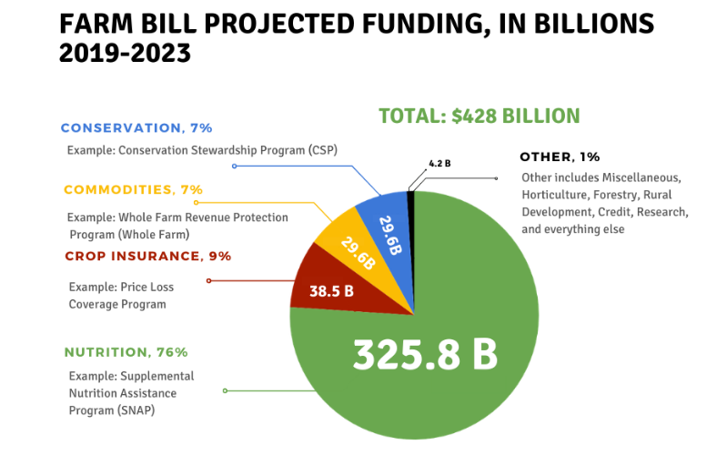
Farm Bill Projected Funding in billions, 2019 - 2023
Notes:
Slide 13: “So what’s in the farm bill? Here you can see the current farm bill programs, divided up by how much of the overall funding is spent on each program. You can see conservation programs and commodities are at 7% each, crop insurance is 9%, and nutrition programs are at 76%. The largest of the nutrition programs is the Supplemental Nutrition Assistance Program, or SNAP, which is our nation’s most important anti-hunger program. The reality is the majority of farm bill spending goes toward critical, safety-net nutrition programs like SNAP. And finally we have this “other” category that receives 1% of overall funding for things like forestry, rural development and research.”

Slide 14
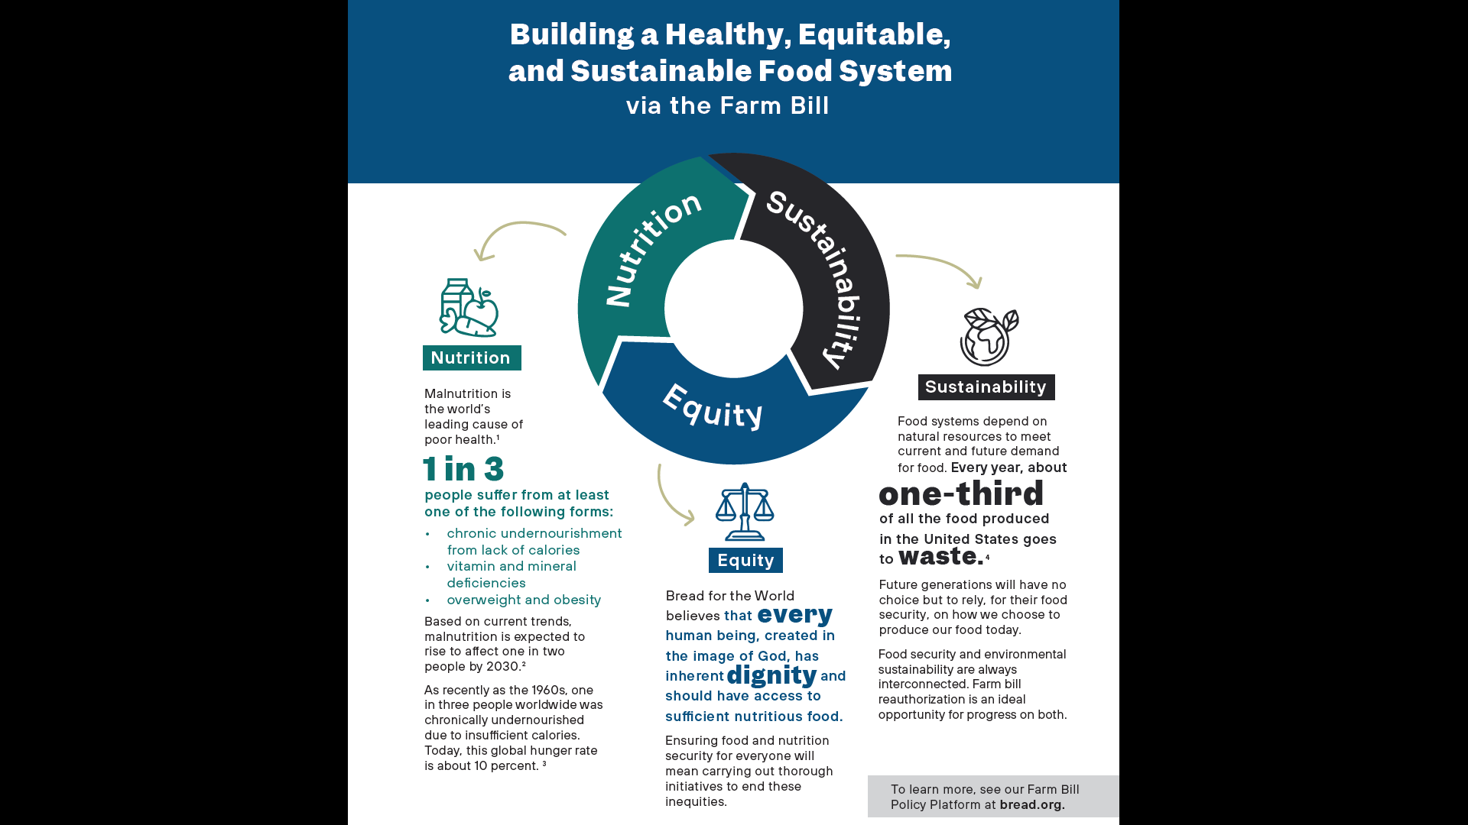
Notes:
Slide 14: “Nutrition programs are a huge part of the farm bill, but we also want to remember that the farm bill impacts and shapes food systems, and that’s how we are approaching it. We are seeking to build a healthy, equitable, and sustainable food system via the farm bill. Those three principles: healthy, equitable, sustainable, which you can see on this slide, guide Bread’s specific farm bill priorities. We are advocating for better nutrition, consideration of vulnerable and marginalized populations, and care for our environment, especially through reduced food waste. You can read Bread’s full 2023 farm bill policy platform online, and we will show you how to find it in just a minute.”

Slide 15
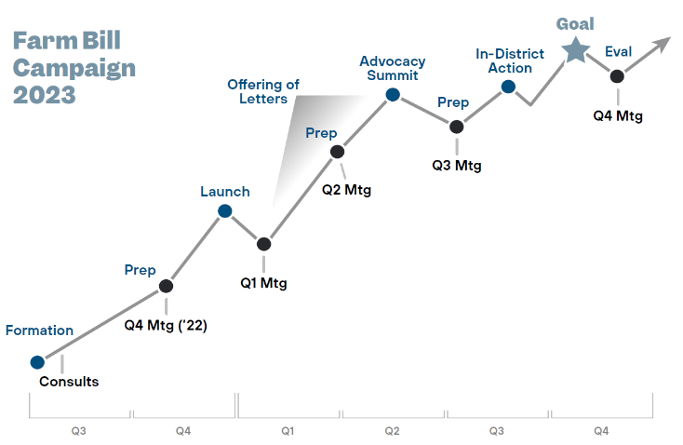
2023 Campaign Timeline
bread.org
Notes:
Slide 15: “Here is Bread’s farm bill campaign timeline. Last year Bread held consultations to prepare for the campaign, which was officially launched in December. You can see the first half of 2023 is the Offering of Letters season, when churches and campuses hold letter-writing events, and that leads to the Advocacy Summit in DC in June. Over the summer, especially August and September, is the season for in-district meetings, when members of Congress are back home. And that leads to our goal for the new farm bill in the fall. You can also see the Q1, Q2, Q3 and Q4 meetings on the timeline. These are regional Zoom meetings where the relevant Bread staff share updates and progress, volunteers share stories of what they’re doing on the ground, and you’re invited to consider next steps to carry the work forward. Your regional organizer can send you the registration link for the next meeting.”

Slide 16
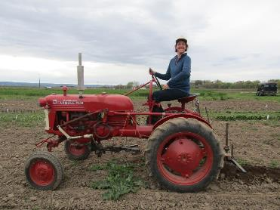
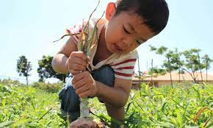
Bread’s 2023 Farm Bill Campaign
Farm Bill campaign launch event – December 6, 2022
Full recording | 3 min. highlights
Notes:
Slide 16: “So here we are. Our farm bill campaign is in full-swing. As mentioned, the campaign launched in December, and there were more than 500 people who participated online and at Bread’s headquarters in Washington, DC. This slide includes a link to the full recording of the launch event and a link to a 3-minute highlights video. The launch culminated with participants committing to hold 178 letter-writing events, which we call an Offering of Letters. Since then, hundreds more churches and groups across the country have said, “Yes, we will hold an Offering of Letters.” We hope that you will as well, and we’re excited to partner with you.”

Slide 17
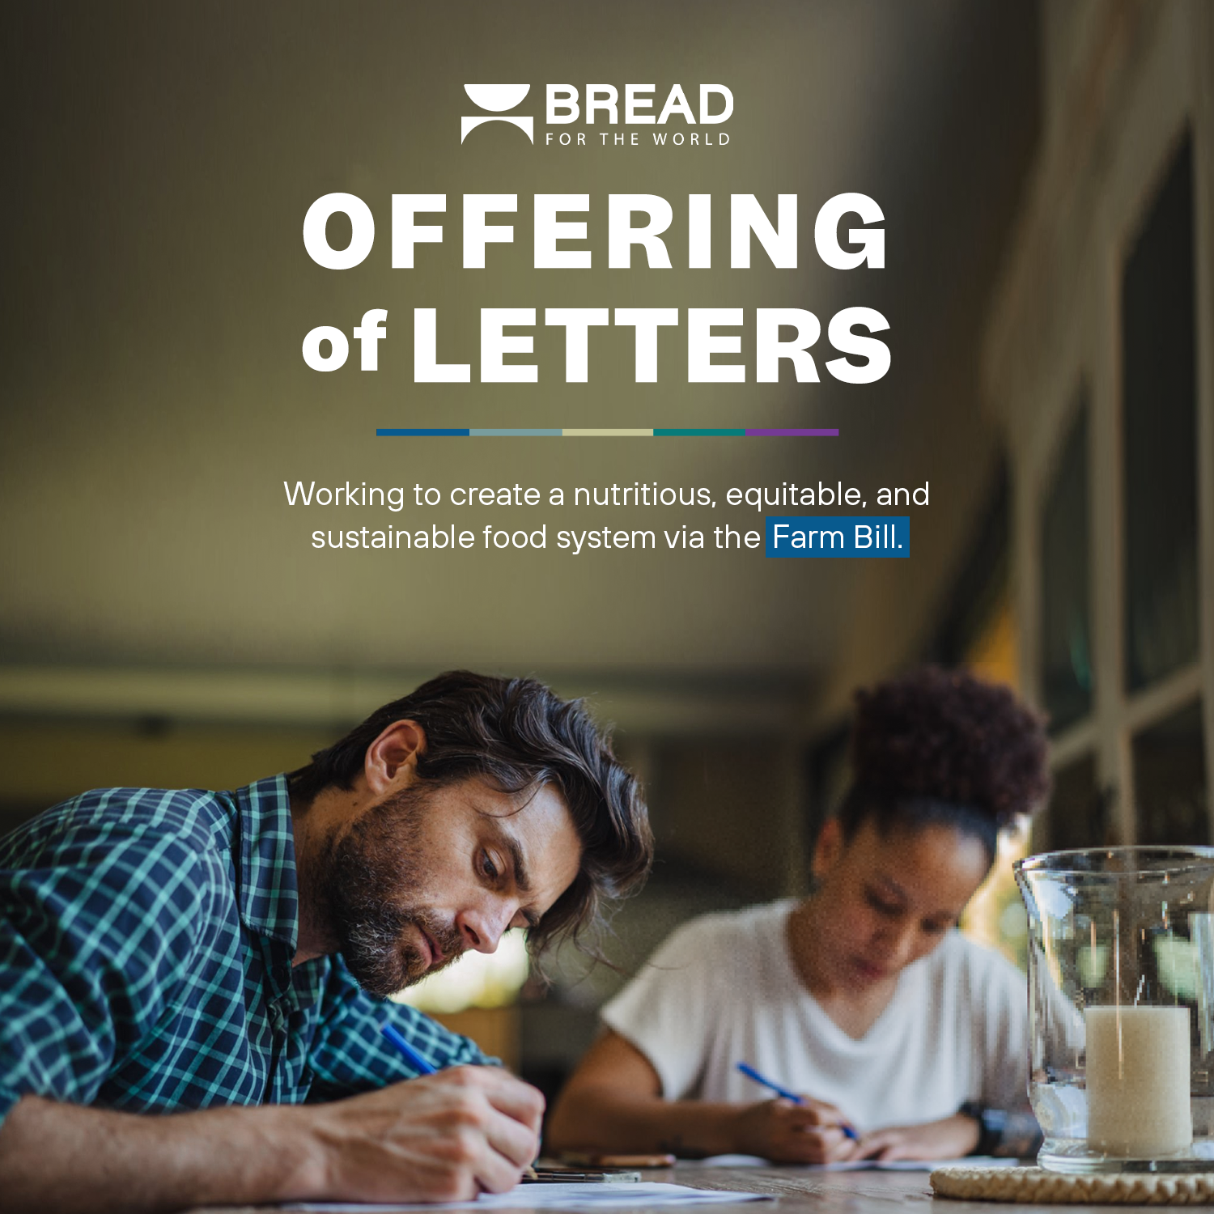
Bread for the World’s
Offering of Letters
Locating the OL website – www.bread.org/ol
Sample letter and fact sheets
How to personalize a letter
How to use the email Congress page as part of your Offering of Letters
Report your results
Contacting your Bread organizer –
www.bread.org/offering-letters/#regional-organizers
Notes:
Slide 17: “And so we come to the Offering of Letters. As we’ve mentioned, an Offering of Letters is simply a letter-writing event, which has deeper meaning rooted in our shared Christian faith. It’s a straightforward advocacy “toolkit” that churches, campuses and small groups can adapt to their own contexts. Each year, Bread for the World hones in on a specific, hunger-related message for the letters, and this year our focus is the farm bill.
The information below assumes the presenter will bring up and display Bread’s Offering of Letters website (www.bread.org/ol). Or, you may instead wish to hold an Offering of Letters at this point.
“We’re going to use these final few minutes to show you Bread’s Offering of Letters website, which will be your go-to hub for the information and resources you’ll need for your event. Your starting point is www.bread.org/ol. [click link on #1 in slide 17, to pull up website] All of the information and resources can be found on this page, by scrolling down. Or, use the jump links on the right or at the top of your screen. The main one you’ll use is under “Resources,” then “Resources to Organize Your Event.” You can see that dropped me down to this handy list of resources. Lots of good stuff here. The most important resource is the OL sample letter, the first on the list. We have some fact sheets, one for each of the three principles mentioned previously, as well as state fact sheets. And here we have Bread’s farm bill platform previously mentioned. And some other good resources, so be sure to browse them on your own.
“Personal, handwritten letters have the most impact, especially when delivered to the local offices and followed up with a personal email to key legislative staff. Organizers can walk you through that. But for those of you who want to include emails as a part of your Offering of Letters, we’ve got you covered. There are a few ways to access the email Congress page, including here. Or, the direct link is www.bread.org/farmbill. On this page, if you’re the person sending the email, you fill out the contact information on the first page, and then click “Step 2 – Click here to proceed to the email.” BUT, before you do that, be sure to check this box, “Yes, this is an Offering of Letters.” AND, be sure to type the name, city and state of the church, campus or organization hosting the event. Try to have everyone who’s participating type the same thing in that box, so that we can properly capture the info on the back end. So you click to proceed, and then you come to the email itself. Just like with handwritten letters, we encourage you to personal the email before sending. That helps it get noticed by congressional staff. After you’ve personalized it, click send, and your email will be sent to both of your senators and your representative.
“And please be sure to report the results of your Offering of Letters. Here’s where you do that. [click “Share Your Results”] We’re asking for one report for each event, not for each letter. So be sure to communicate with your team, so you know who is doing that. The report asks how many letters were sent to each member of Congress. Don’t worry about emails; we are tracking those on the back end. Just include letters in that count.
“Last but certainly not least, remember that your Bread organizers are here to help. You can find and contact your organizer by clicking “Regional Organizers,” select your state to see your organizer, and click “learn more” for his or her contact info. Reach out to your organizer if you have any questions about holding an Offering of Letters!”

Slide 18
“The LORD bless you and keep you; the LORD make his face shine on you and be gracious to you; the LORD turn his face towards you and give you peace.”
Numbers 6:24-26
Notes:
Slide 18: “Thank you very much for your attention and engagement during this presentation. We’ll close with a benediction: The Lord bless you and keep you; the Lord make his face shine on you and be gracious to you; the Lord turn his face toward you and give you peace. [pause] Amen.”

